Slide 1

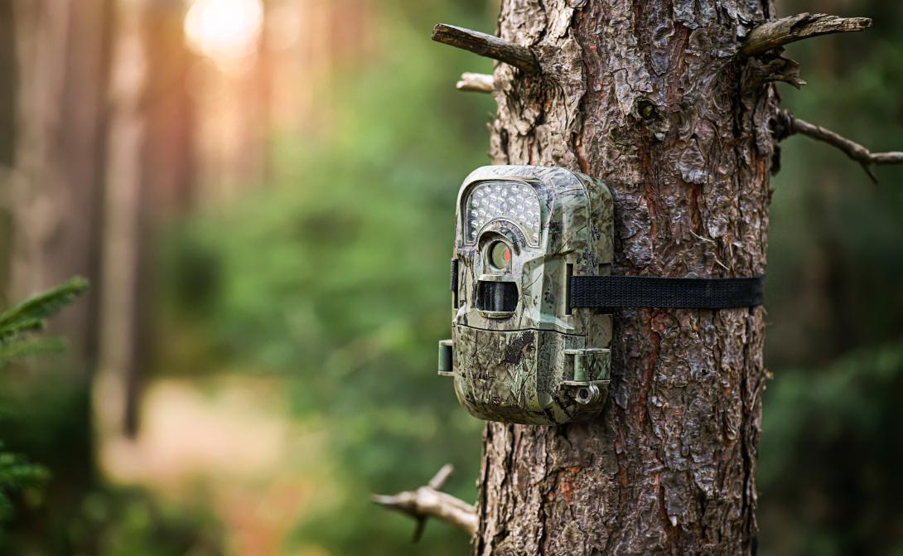

Wildlife
Image Classifier
The True Positives
Notes:
Sharon from slides 1-4

Slide 2




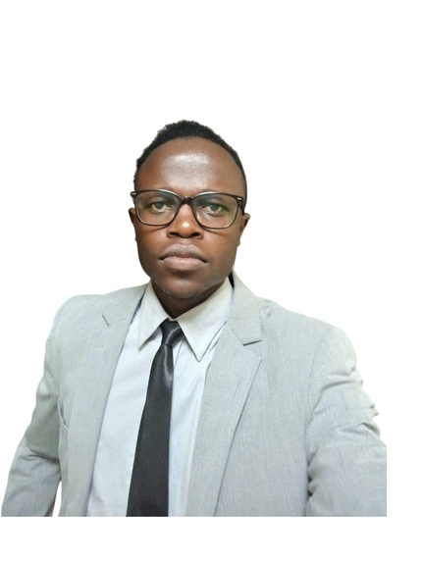
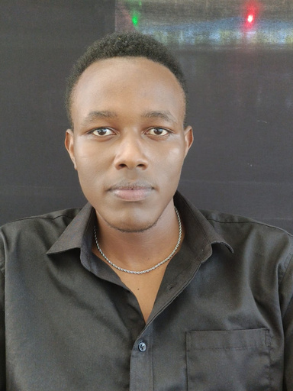
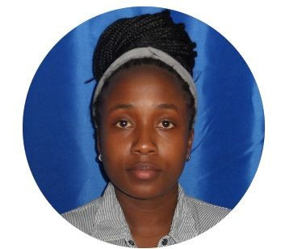
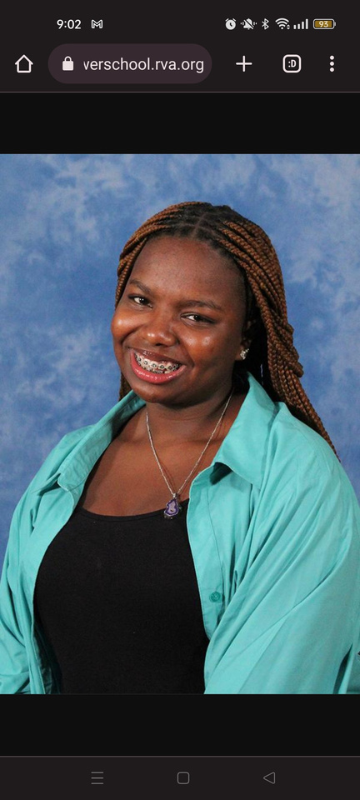


Our Team
Habshi
Pedro
Ian
Bett
Sharon
Paul
Wambui
Kamotho
Frankline
Kipchumba

Slide 3
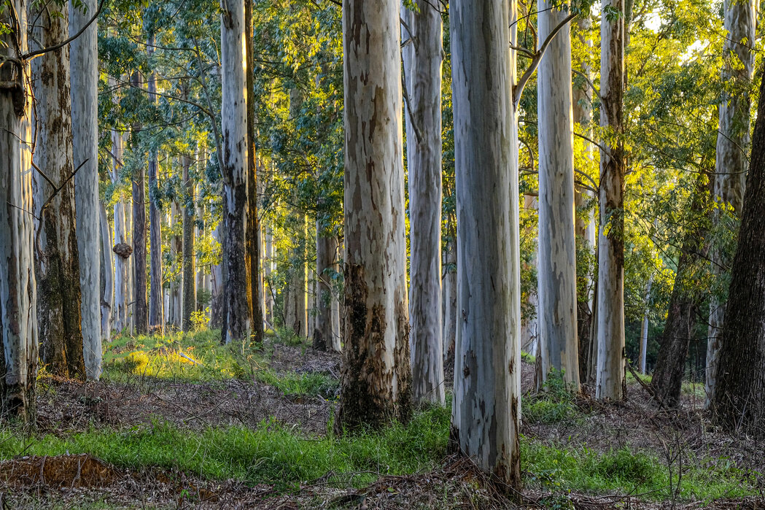
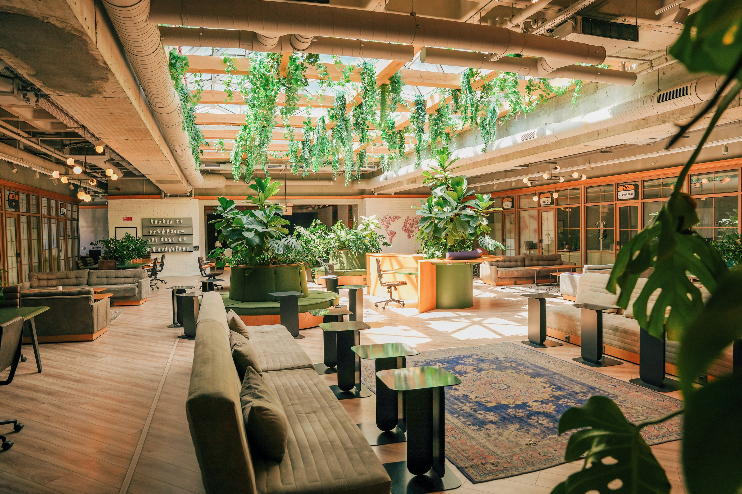

Introduction
Conservationists now use camera traps to monitor wildlife with minimal disruption, but these devices generate more images than humans can feasibly review. Our goal is to build an AI model that automatically identifies animals in these images, helping conservationists make faster, data-driven decisions

Slide 4






Objectives
01
02
03
04
To create a model that will classify images of wildlife by their species, enabling conservationists to understand animals’ behavior patterns, movement, and population trends.
To get a fuller understanding of animal patterns and spot deviations quickly.. Biodiversity conservation by quickly identifying struggling species or invasive species.
To support the tourism industry by allowing guides to know the exact locations of different animals with minimal disruption of habitats and optimizing resource use.
To learn more about different animals and their interactions with each other.

Slide 5




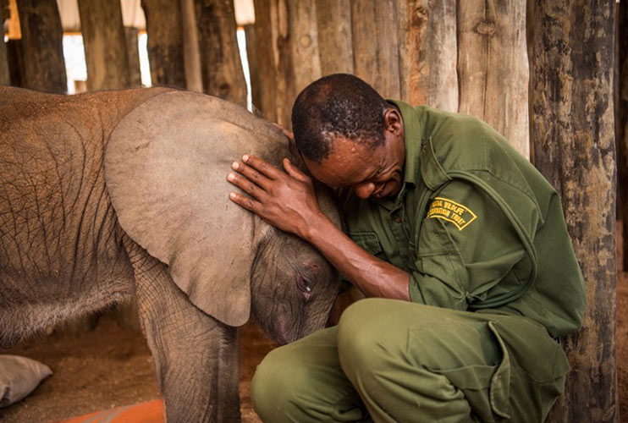
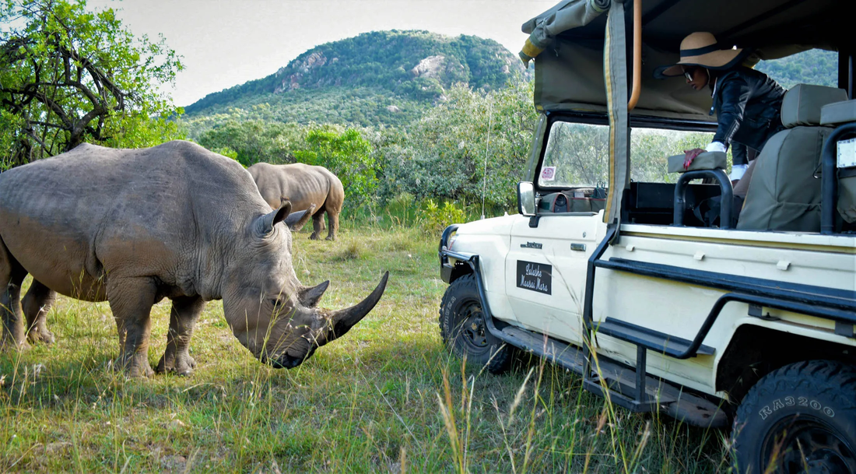
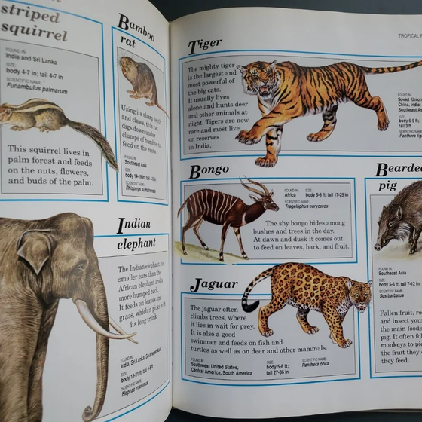
Target Audience
WIldlife conservationists
Safari & Tourism companies
Academics
In Kenya the KWS and other privately funded companies work tirelessly to preserve our wildlife and keep them safe.
Tourism allows those from different places to visit and see the wonderful things nature has to offer. It also helps boost local economies.
Learning about different animals and documenting their characteristics and traits preserves precious knowledge
Notes:
Wambui for the next 3

Slide 6
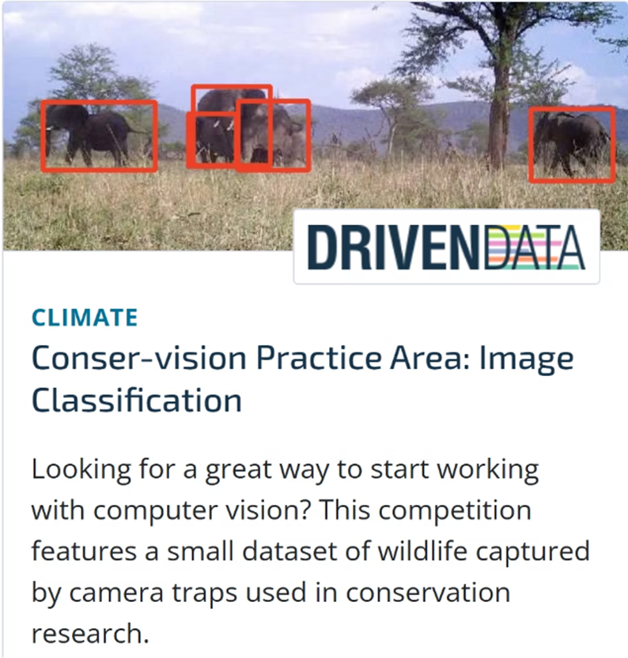
Data
The data is from an ongoing competition on DrivenData through a partnership with the Wild Chimpanzee Foundation and the Max Planck Institute for Evolutionary Anthropology. The camera traps are located in Taï National Park in Côte d'Ivoire

Slide 7
The dataset is comprised of over 16,000 manually labeled images by researchers in Taï National Park.
Each image in this data set is labeled as one of 7 creatures: birds, civets, duikers, hogs, leopards, monkeys, rodents. Images with no animal on them are labeled blank.
Features and What They Represent
id: Unique identifier for the image.
filepath: Path to the image file.
site: Camera trap location site ID.
Label Columns (e.g., leopard, bird, hog, etc.): Binary indicators for species presence.

Slide 8


Methods
To create a multi-label image classification pipeline for camera trap images:
Data was imported, analyzed, and preprocessed.
Four CNN-based models were trained and evaluated: a Baseline CNN, MobileNetV2, ResNet50, and a Custom CNN with regularization.
The baseline CNN was determined to be the best-performing model based on micro and macro ROC-AUC.
Notes:
Habshi because it is what he worked on

Slide 9

Evaluation Metrics
Micro ROC-AUC: Best for imbalanced multi-label problems. Higher = better.
Macro ROC-AUC: Averages performance per label, regardless of frequency.
Exact Match: Strict metric; must get all labels correct.
Model | Micro ROC-AUC | Macro ROC-AUC | Exact Match
Baseline CNN | 0.5188 | 0.4964 | 0.1028
MobileNetV2 | 0.5127 | 0.5054 | 0.1025
ResNet50 | 0.5160 | 0.4982 | 0.0106
Custom CNN | 0.4878 | 0.4940 | 0.0513

Slide 10
Value accuracy
Model | Final Value Accuracy | Intepretation
Baseline CNN | 82.4% | Very strong for a simple model
MobileNetV2 | 76.7% | Good performance, fast inference, but slightly below Baseline
ResNet50 | 33.5% | Likely underfitting or not well fine-tuned
Custom CNN(reg) | 35.7% | Struggling despite regularization

Slide 11
Recommendations
Class Imbalance: Apply techniques such as class weighting, oversampling rare classes, or using focal loss to improve learning for minority species.
Label Quality Review: Perform manual checks or automated noise reduction techniques to improve the quality of image labels.
Increase Training Duration: Train models for more epochs with early stopping to allow better convergence.
Use Higher Resolution Images: Invest in camera traps which are able to capture higher quality images.
Notes:
Ian Bett up to deployment

Slide 12
Efficiency
Using Artificial intelligence for image classification reduces manual effort by up to 90%
Business Impact
Accuracy
With a good model, you get consistent classification and removes human error
Scalability
Such a project is easily extended to new parks, regions, and species.

Slide 13
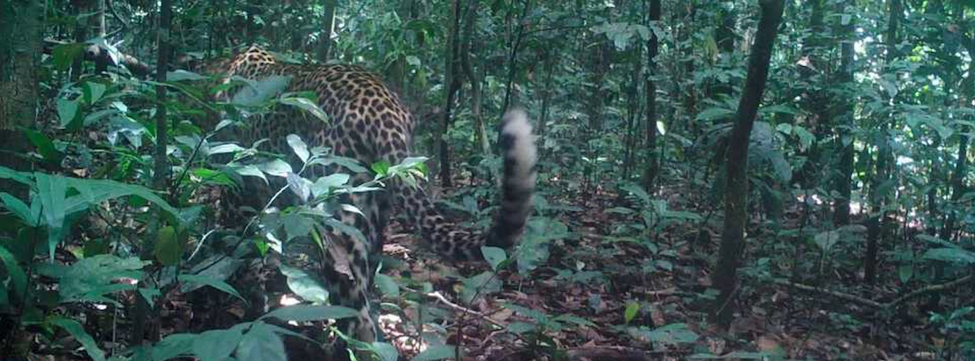


RESULTS
We have created an image classification model capable of identifying images with high accuracy. This model has now been deployed using Flask is available for you to use.

Slide 14


Deployment
Notes:
I will stop sharing my screen and hand over to Franklin who will take over and walk us through deployment.

Slide 15
Questions?

